Slide 1
KERBEROS AUTHENTICATION
21522797 – LÊ HUỲNH QUANG VŨ

Slide 2
01
Overview

Slide 3
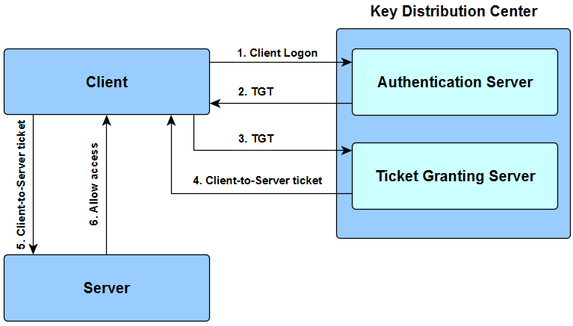
How Kerberos Authentication Works

Slide 4
02
Explanation

Slide 6
The user enters the login and password.

Slide 7
The cleartext user ID goes to the Authentication Server (AS) with a request for services on behalf of the user.

Slide 8

AS checks if the user login is in the database
If there is information about that user, then AS can generate a client secret key according to the user’s ID and password

Slide 9
AS sends to user:
The client/TSG session key (encrypted with the client secret key)
TGT including the user ID, network address and ticket validity period + Client/TGS session key (encrypted with the TGS secret key).

Slide 10
The user decodes the first message but can’t decode the second one, because the user doesn’t have the TSG secret key. The client sends message to the TGS:
The TGT received from AS + Server ID + TGS/Client secret key (encrypted with the TGS secret key);
The authenticator including the client ID and timestamp (encrypted with the Client/TSG session key).

